Slide 1


Prediction of Research Octane Number(RON) using Machine Learning Models
Gaurav (2001CB22)
Shivansh Srivastava(2001CB49)
BTP Supervisor: DR. NITIN DUTT CHATURVEDI

Slide 2
INTRODUCTION
Our Project is to develop the predictive model that can accurately estimate the Research Octane Number(RON) for processes based on their attributes. By analyzing the dataset and identifying patterns and relationships, the model will provide insights into the factors influencing Research Octane Number.
The project will involve several steps, including Exploratory Data Analysis, feature selection, model selection, and evaluation.
Various Supervised machine learning algorithm like Polynomial regression, Decision trees, Random forests, will be explored and evaluated to determine the most effective model for RON prediction

Slide 3
Heavy Naphtha feed to a CCR Reformer unit typically contains C6 to C11 paraffins, naphthenes and aromatics. The purpose of this reforming process is to produce high octane aromatics from paraffins and naphthenes for use as a high octane blending component.
Naphthenes convert rapidly and efficiently to aromatics. Paraffins do not, requiring higher severity conditions and even then conversion is slow and inefficient. In this process conversion is achieved by passing the naphtha over a slow moving bimetallic catalyst bed in four adiabatic reactors, in the presence of hydrogen at relatively high temperature and low pressure. Operating under these conditions of low pressure and high temperature, the rate of coke lay down on the catalyst is relatively high

Slide 4
DATA SET ANALYSIS
The dataset consist of 250 rows and 9 columns
Attribute are Date and Time, WAIT, R-01 Endotherm, Total Endotherm, Feed density, Regen catalyst, naptha/Aromatics, Throughput and RON.
The dataset contains No null values so data pre-processing part can be ignored.
Our Target Variable is Research Octane Number(RON):It's a measure of the performance of gasoline or petrol fuel blends and their ability to resist knocking or pinging during combustion in internal combustion engines. A higher RON indicates better resistance to knocking and better performance in high-compression engines, which is crucial for efficient and smooth engine operation.

Slide 5
Date and Time:
While not directly related to chemical properties, temporal data might indirectly influence operations. For instance, seasonal variations could impact crude oil quality or refinery throughput.
WAIT:
WAIT might stand for "Weighted Average Injection Temperature." Temperature plays a crucial role in various processes within a refinery. It can affect reaction rates, product quality, and energy consumption.
R-01 Endotherm:
This could represent the endothermic heat absorbed in a particular reactor (R-01). Endothermic reactions require heat input and are common in processes like catalytic reforming or steam reforming.
Total Endotherm:
The total endotherm likely encompasses the collective heat absorption across multiple reactors or processes. Monitoring this helps in managing energy requirements and understanding reaction kinetics.
Feed Density:
Feed density could refer to the mass or volume of the feedstock introduced into a specific unit or process. It's vital for maintaining process efficiency and ensuring optimal reactor performance.

Slide 6
6.Regen Catalyst:
This might denote the regeneration process of catalysts used in various refining or chemical processes. Catalyst regeneration is crucial for maintaining catalyst activity and improving product yield.
7.Naphtha/Aromatics:
This likely represents the ratio between naphtha and aromatics in the feed. Naphtha and aromatics are important constituents in gasoline blending, and their ratio affects product properties like octane rating.
8.Throughput:
Throughput refers to the quantity of feedstock processed within a specific unit or timeframe. Managing throughput is critical for optimizing production and ensuring equipment operates within designed capacities.
Each of these features seems to relate to different aspects of refinery operations, process variables, or feedstock characteristics. Understanding their impact on product quality, reaction kinetics, energy consumption, and catalyst performance is crucial for optimizing refinery processes and predicting the quality (RON in this case) of the final product

Slide 7
Features Analysis

Slide 8
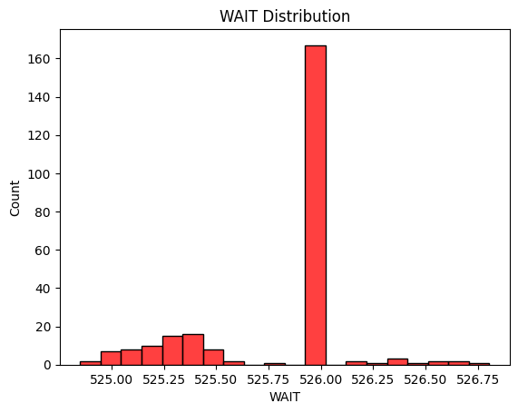
WAIT DISTRIBUTION
In the dataset, most of the values is 526.00 which is more than 70% data.
It is not important features for model evaluation so we can skip this features for model selection.

Slide 9
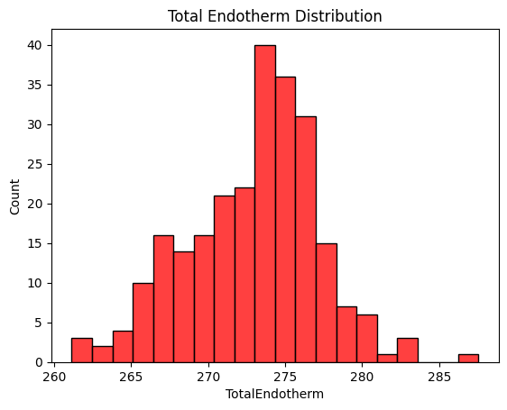
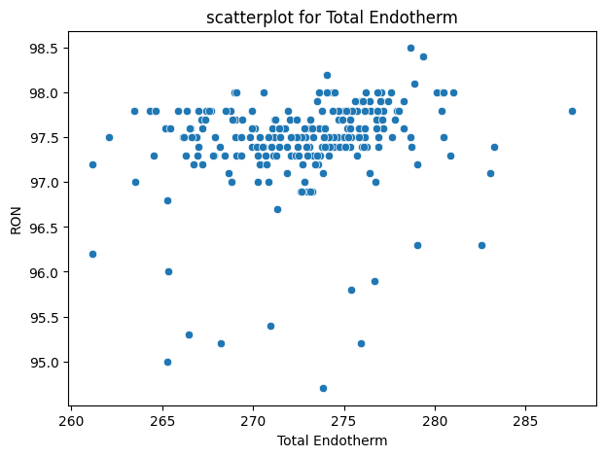
Total Endotherm has significant variation over the data
We can use it for feature Selection.

Slide 10
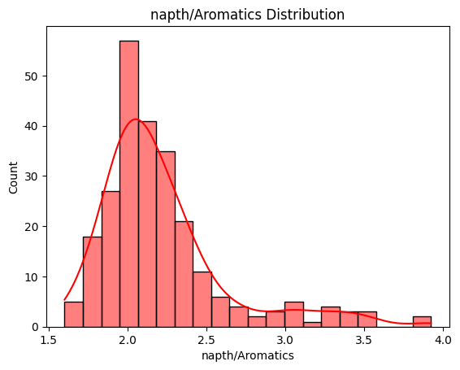
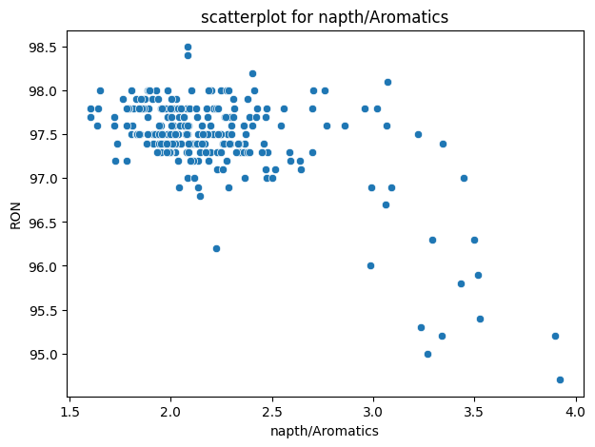
As we direct observe that Naptha/Aromatics ratio inversely related with Research Octane Number as Naptha/Aromatics ratio increases Research Octane Number decreases.
So, this Feature can be one of the most important feature for prediction RON.

Slide 11
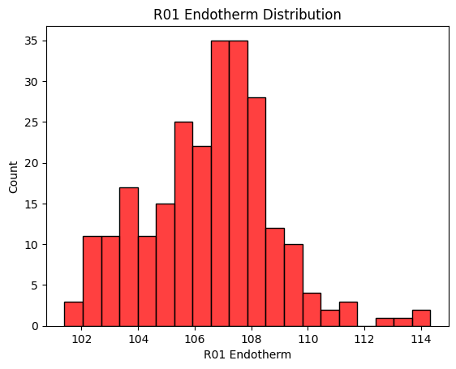
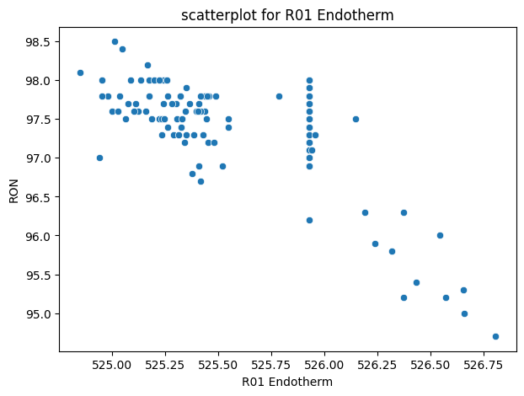
Similarly, RO1 endotherm inversely related with Research Octane Number as if it increases then Research Octane Number decreases.
So, this Feature can be one of the most important feature for prediction RON.

Slide 12
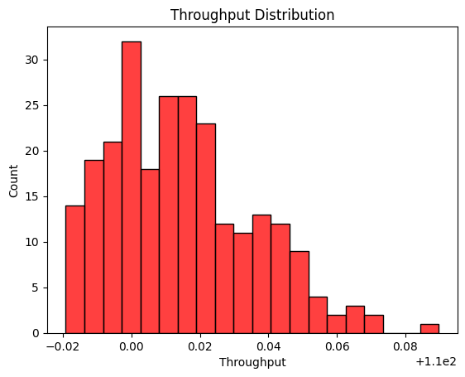
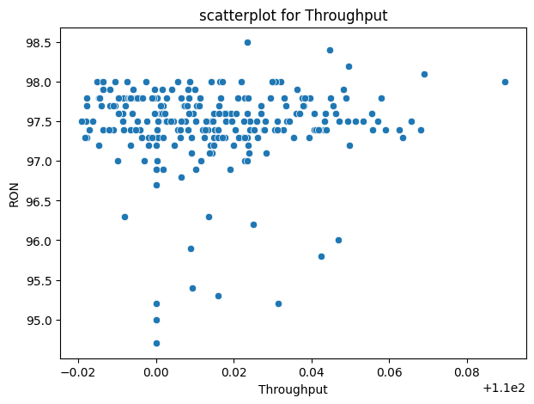
We can easily observe that Our target Variable is almost Constant with variation of Throughput
It indicates that Throughput is not significant for predicting target variable
So, We will not be using this feature for Model Evaluation

Slide 13
Correlation Matrix
A correlation matrix is a table displaying the correlation coefficients between multiple variables in a dataset. It represents how strongly and in what direction pairs of variables are related to each other. The correlation coefficient, usually denoted by 'r', ranges between -1 and +1:
Positive Correlation (+1): When one variable increases, the other tends to increase as well.
Negative Correlation (-1): When one variable increases, the other tends to decrease.
No Correlation (0): There's no apparent linear relationship between the variables.
The correlation matrix showcases these relationships in a symmetrical table format, with variables on both the rows and columns. The diagonal elements represent the perfect correlation of a variable with itself (always 1).

Slide 14
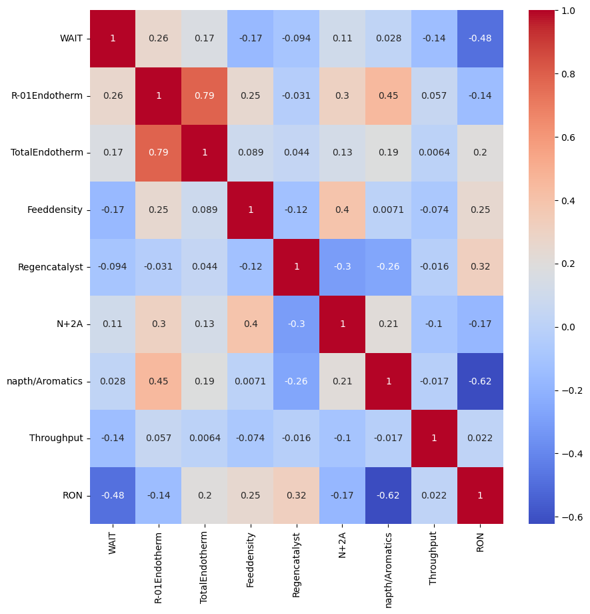

Slide 15
Features Selections
We use Following Attribute for model Selection
Total Endotherm
Naptha/Aromatics
Regen Catalyst
R-o1 Endotherm
Feed density
Wait and Throughput are very less significant as their effect on RON is very less, so we are not using these parameters for model Evaluation.

Slide 16
Models Evaluation

Slide 17
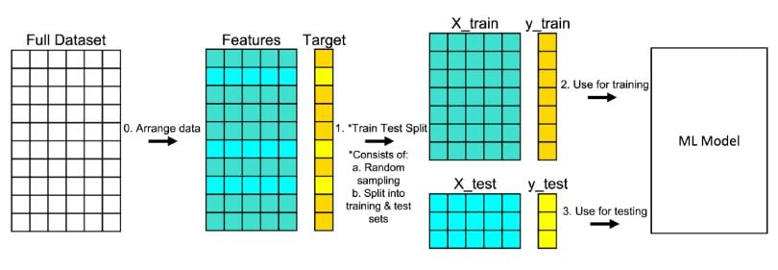
Train Test Split
Training Set: This subset (usually a larger portion, like 80% of the data) is used to train the machine learning model. The model learns the patterns and relationships within this data.
Test Set: The remaining portion (20%) is kept separate and not used during training. It's used to evaluate how well the model performs on new, unseen data. The model's predictions on the test set are compared against the actual values to assess its performance and generalization ability.

Slide 18
Supervised Machine Learning
Labeled Training Data: Supervised learning relies on labeled datasets, where each input data point is paired with a corresponding output label. This pairing allows algorithms to learn the relationship between features and labels.
Prediction of Target Variable: These algorithms predict a target variable (such as a category or quantity) based on input features. Classification algorithms predict categories or classes, while regression algorithms predict continuous numerical values.
Learning from Examples: They learn patterns and relationships from examples in the training data. By generalizing from known examples, these algorithms make predictions on new, unseen data.
Types of Algorithms: Supervised learning encompasses various algorithms like linear regression, logistic regression, decision trees, random forests, support vector machines, Each algorithm has its strengths, weaknesses, and suitability for different types of problems

Slide 19
Polynomial Regression
Decision Tree Regression
Random forest Regression

Slide 20
Polynomial Regression
Higher-Order Relationships: It captures nonlinear relationships between variables by using higher-degree polynomial equations (quadratic, cubic, etc.) rather than just a straight line.
2.Equation Form: The equation of a polynomial regression model of degree n takes the form: y=β0​+β1​x+β2​x2+β3​x3+⋯+βn​xn+ϵ Here, β0​,β1​,β2​,…,βn​ are coefficients to be estimated, x represents the independent variable, and y is the dependent variable. ϵ denotes the error term.
3.Degree Selection: The choice of the polynomial degree n is crucial. Higher-degree polynomials can fit the training data more closely but might lead to overfitting, resulting in poor performance on new data. Conversely, lower-degree polynomials might oversimplify the relationship.
4.Fitting the Model: The model is fitted to the data using techniques like the method of least squares, minimizing the sum of squared differences between actual and predicted values.

Slide 21
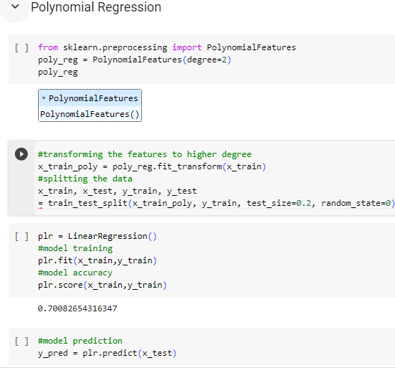
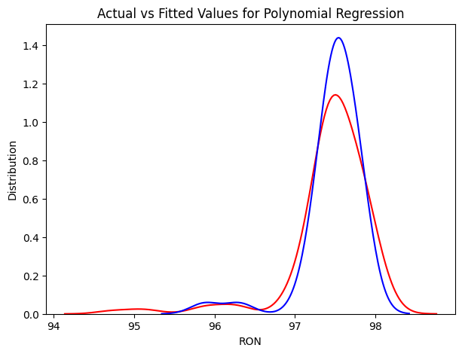

Slide 22
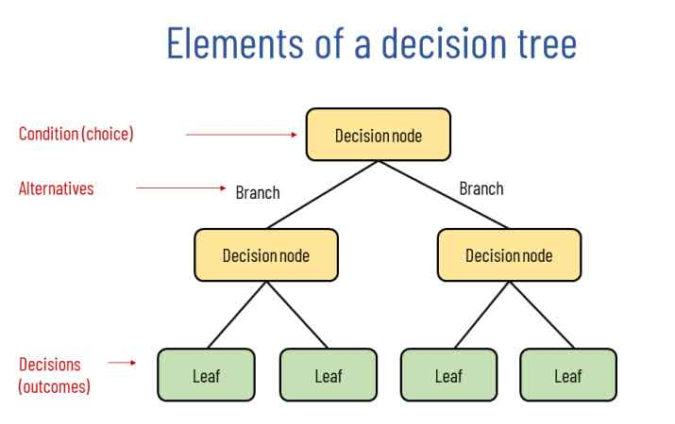
Decision Tree Regression

Slide 23
Hierarchical Structure: It uses a tree-like model, where each internal node represents a feature, each branch represents a decision rule based on that feature, and each leaf node represents the predicted continuous value.
Recursive Splitting: The tree is built by recursively splitting the dataset into smaller subsets based on the feature that best separates the data according to a selected criterion (commonly mean squared error or variance reduction).
Prediction: To predict the target variable for a new instance, it traverses the tree from the root node down to a leaf node, and the output is the mean (or weighted mean) of the target values in that leaf node.
Handling Nonlinear Relationships: They can capture nonlinear relationships between features and target variables. However, they might struggle with complex relationships that require a higher level of granularity.
Feature Selection: Decision trees provide a measure of feature importance, indicating which features are more relevant in predicting the target variable.
Hyperparameters: Parameters like tree depth, and the number of features considered at each split are essential for tuning to achieve optimal performance.

Slide 24
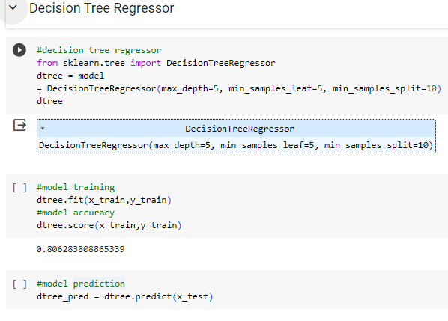
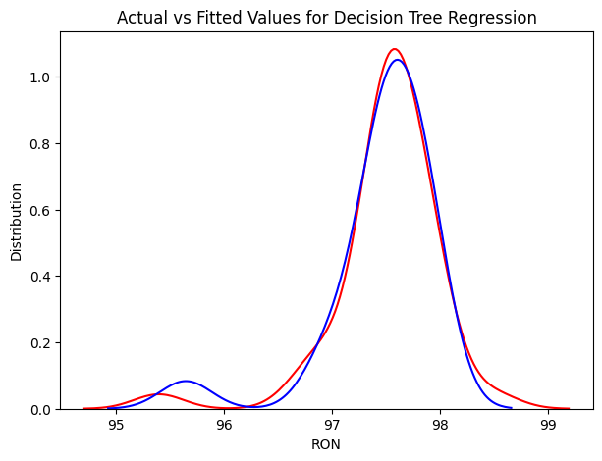

Slide 25
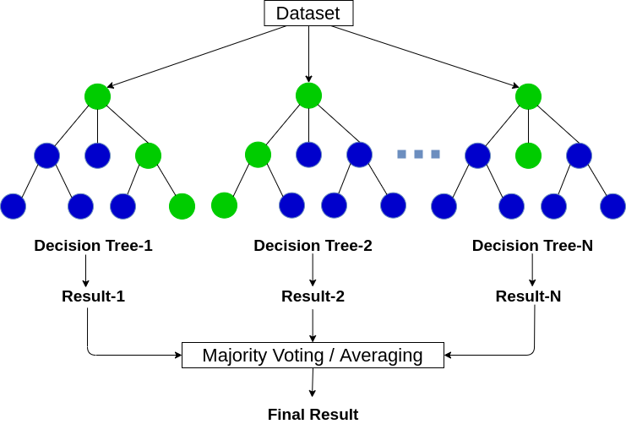
Random Forest Regression

Slide 26
Ensemble of Decision Trees: It builds multiple decision trees using subsets of the training data and randomly selected subsets of features. Each tree is trained independently.
Bootstrap Aggregating (Bagging): Random forest uses a technique called bagging, where each tree is trained on a bootstrapped sample of the data (sampling with replacement). This creates diverse trees that collectively offer better performance than a single decision tree.
Random Feature Subset: At each node of each decision tree, only a random subset of features is considered for splitting. This randomness reduces correlation between trees and leads to higher diversity among them.
Prediction Aggregation: In regression tasks, the final prediction is the average (or weighted average) of predictions made by individual trees. This averaging smooths out individual tree predictions, resulting in a more stable and accurate prediction.
Robustness and Generalization: Random forests are less prone to overfitting compared to single decision trees, as they reduce variance by combining multiple models.
Feature selection: It provides a measure of feature importance based on how much each feature reduces the error across all trees in the forest.
7.Hyperparameters: Parameters like the number of trees in the forest, tree depth, and the number of features considered at each split are essential for tuning to achieve optimal performance.

Slide 27
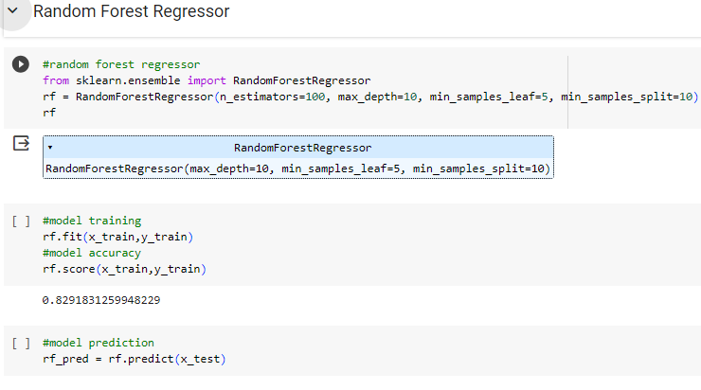
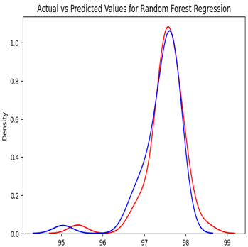

Slide 28
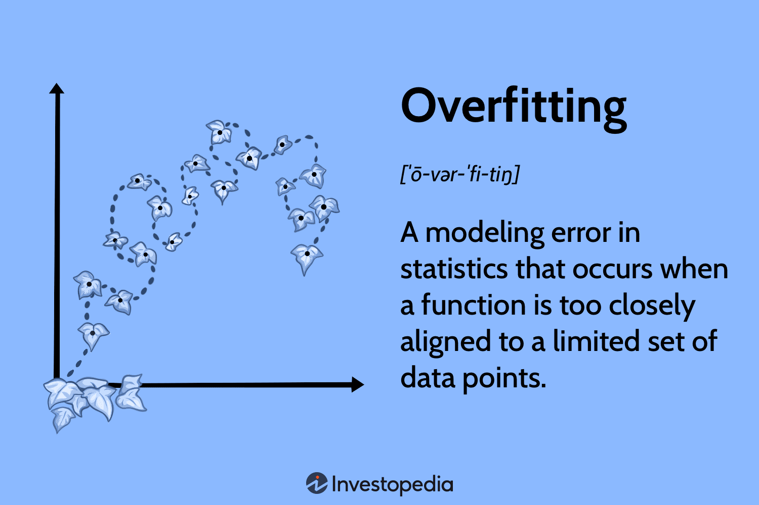
Problem of Overfitting
Key signs and causes of overfitting:
High Training Accuracy, Low Test Accuracy:
Overly Complex Models:
Limited Data:
Lack of Generalization:
Ways to mitigate overfitting:
Train with More Data
Simplify the Model
Cross-Validation
Regularization
Early Stopping:
Ensemble Methods.

Slide 29
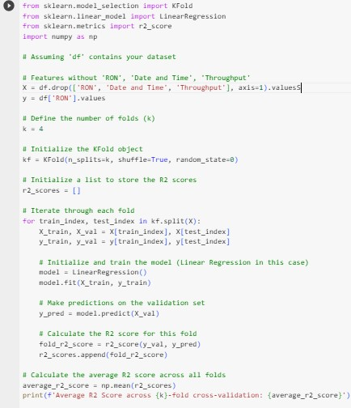
Cross-Validation
Splitting Data: Divide the dataset into k subsets or folds.
Iterating through Folds: For i=1 to k:
Use fold i as the validation set.
Train the model on the remaining k−1 folds.
Evaluate the model's performance on fold i.
Calculate the error (e.g., mean squared error for regression, accuracy for classification) for each iteration.
Calculate Accuracy: Compute the average error across all k iterations to estimate the model's performance.

Slide 30
Results and Conclusions
Polynomial Regression Model we used for predicting Research Octane Number has accuracy about 70%
Decision tree Regression Model we used for predicting Research Octane Number has accuracy about 80%
Random Forest Regression Model we used for predicting Research Octane Number has accuracy about 82%
Random forest gives the best result for predicting RON with highest accuracy
Random forests outperform singular decision trees due to ensemble learning, combining multiple trees to reduce overfitting and variance while capturing complex patterns and feature importance, making them robust, effective, and versatile for various datasets and tasks.

Slide 31
What we will do next
We will Explore some advance machine algorithm for predicting target variable
We will use Deep learning models for better estimation of Research Octane Number.
After Evaluation we will deploy the models so that it will enable easy access and utilization of the deep learning model for others by deploying it efficiently. This involves creating a seamless integration of the model into an accessible system or platform, ensuring a user-friendly interface or API for straightforward interaction.

Slide 32
Thank You

